Slide 1


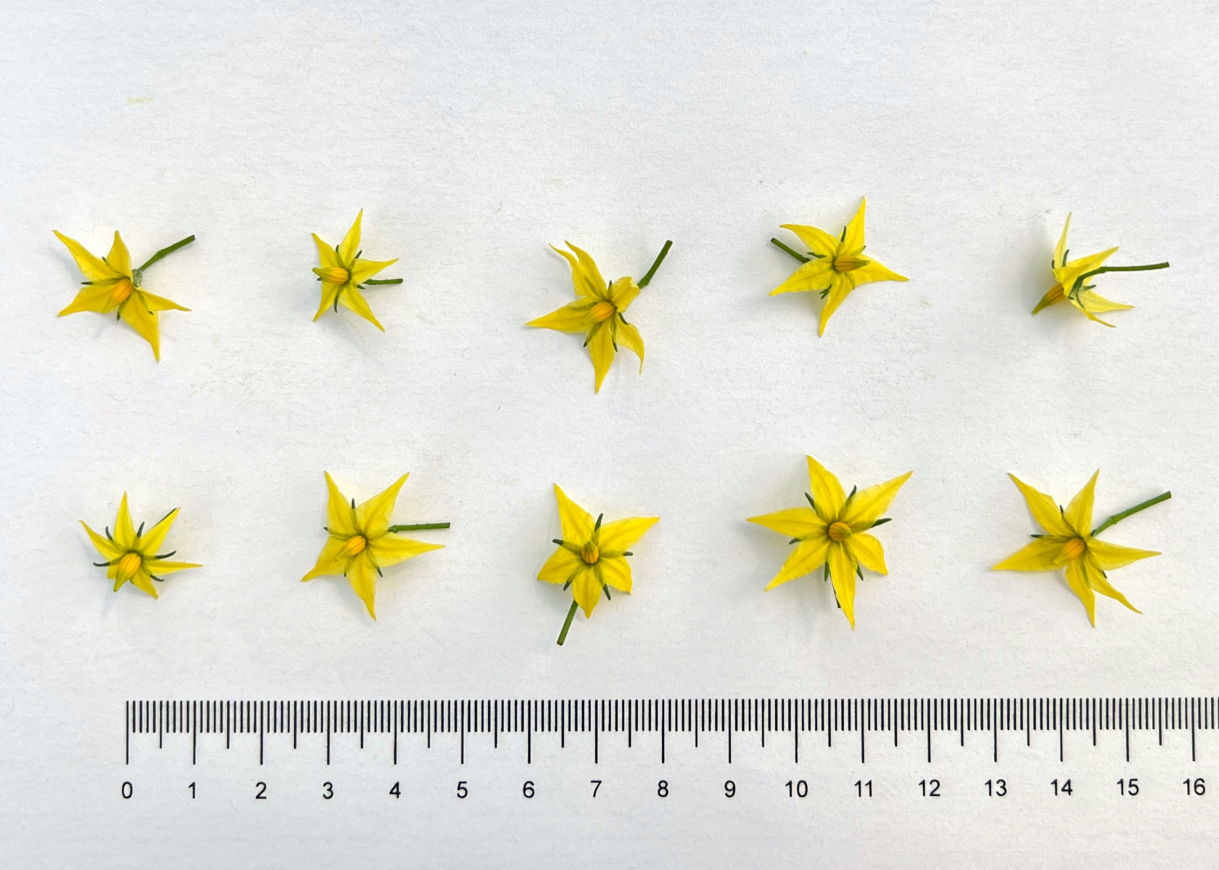
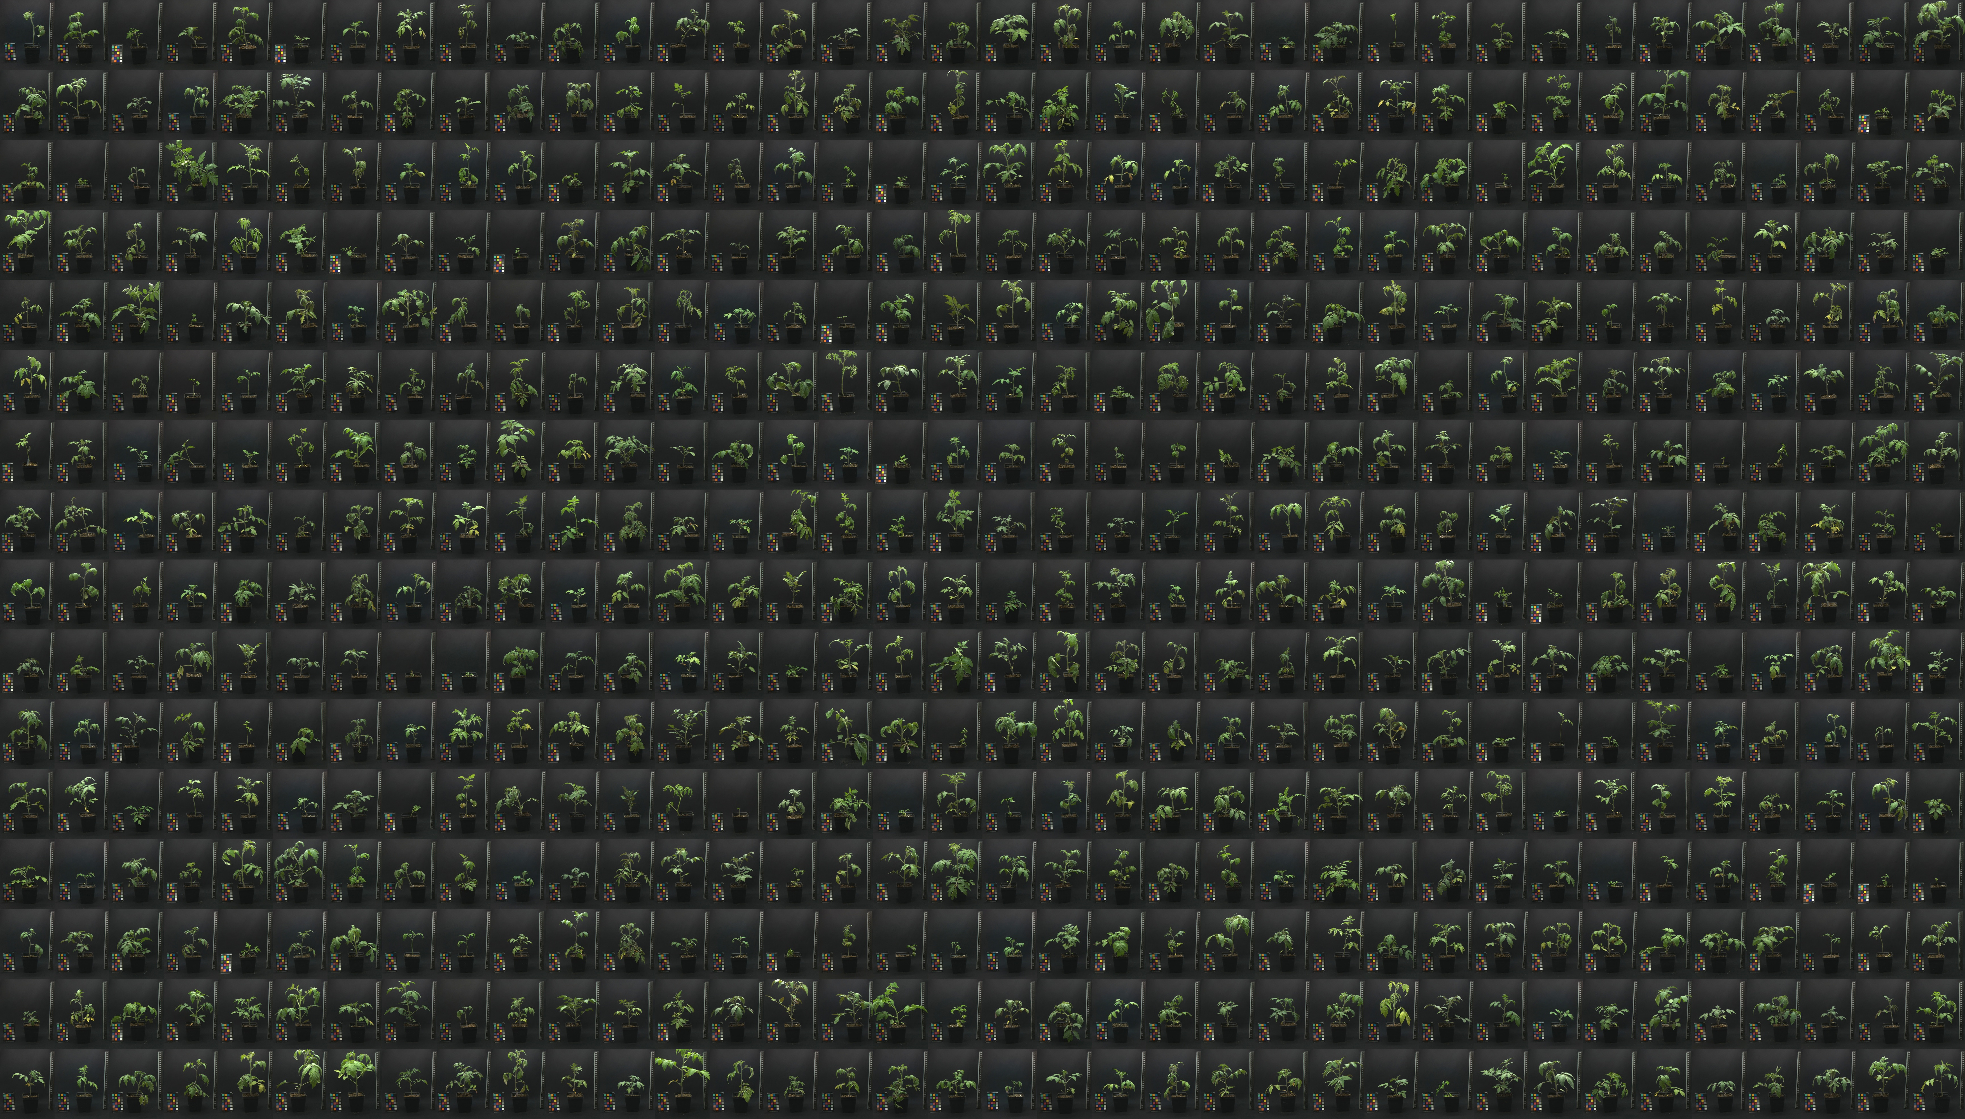
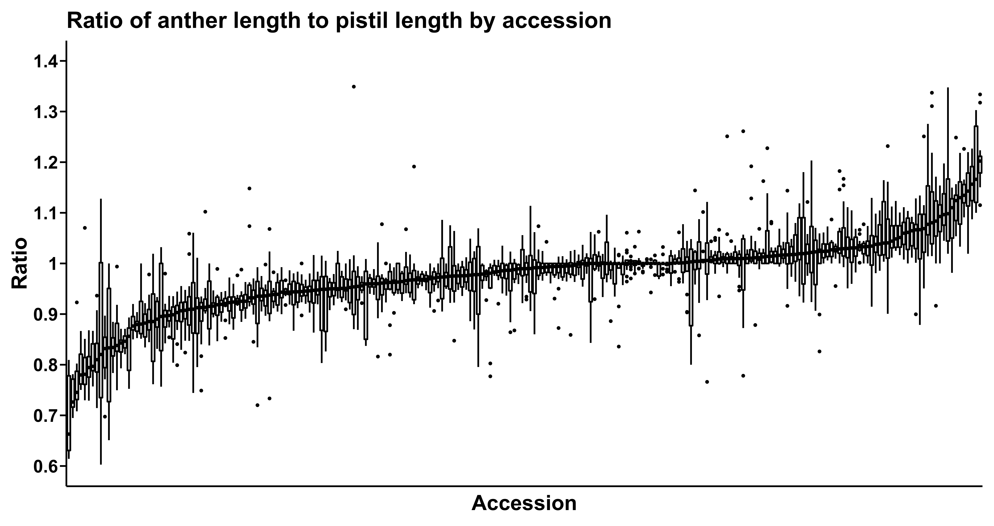
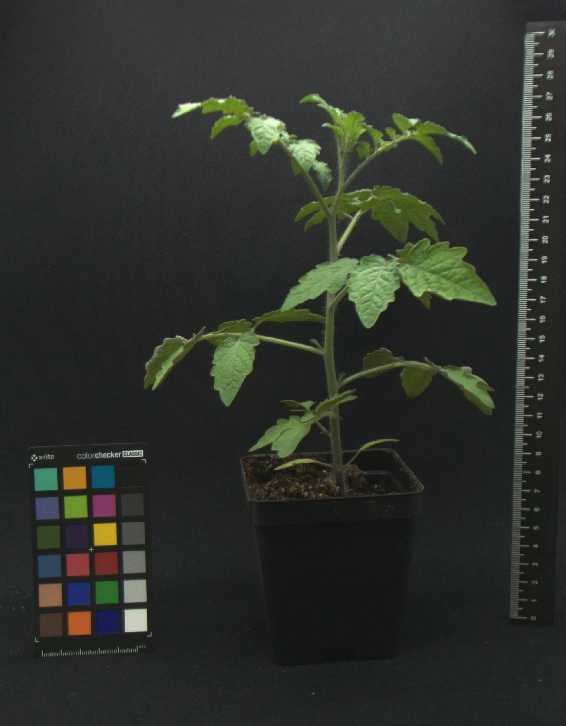
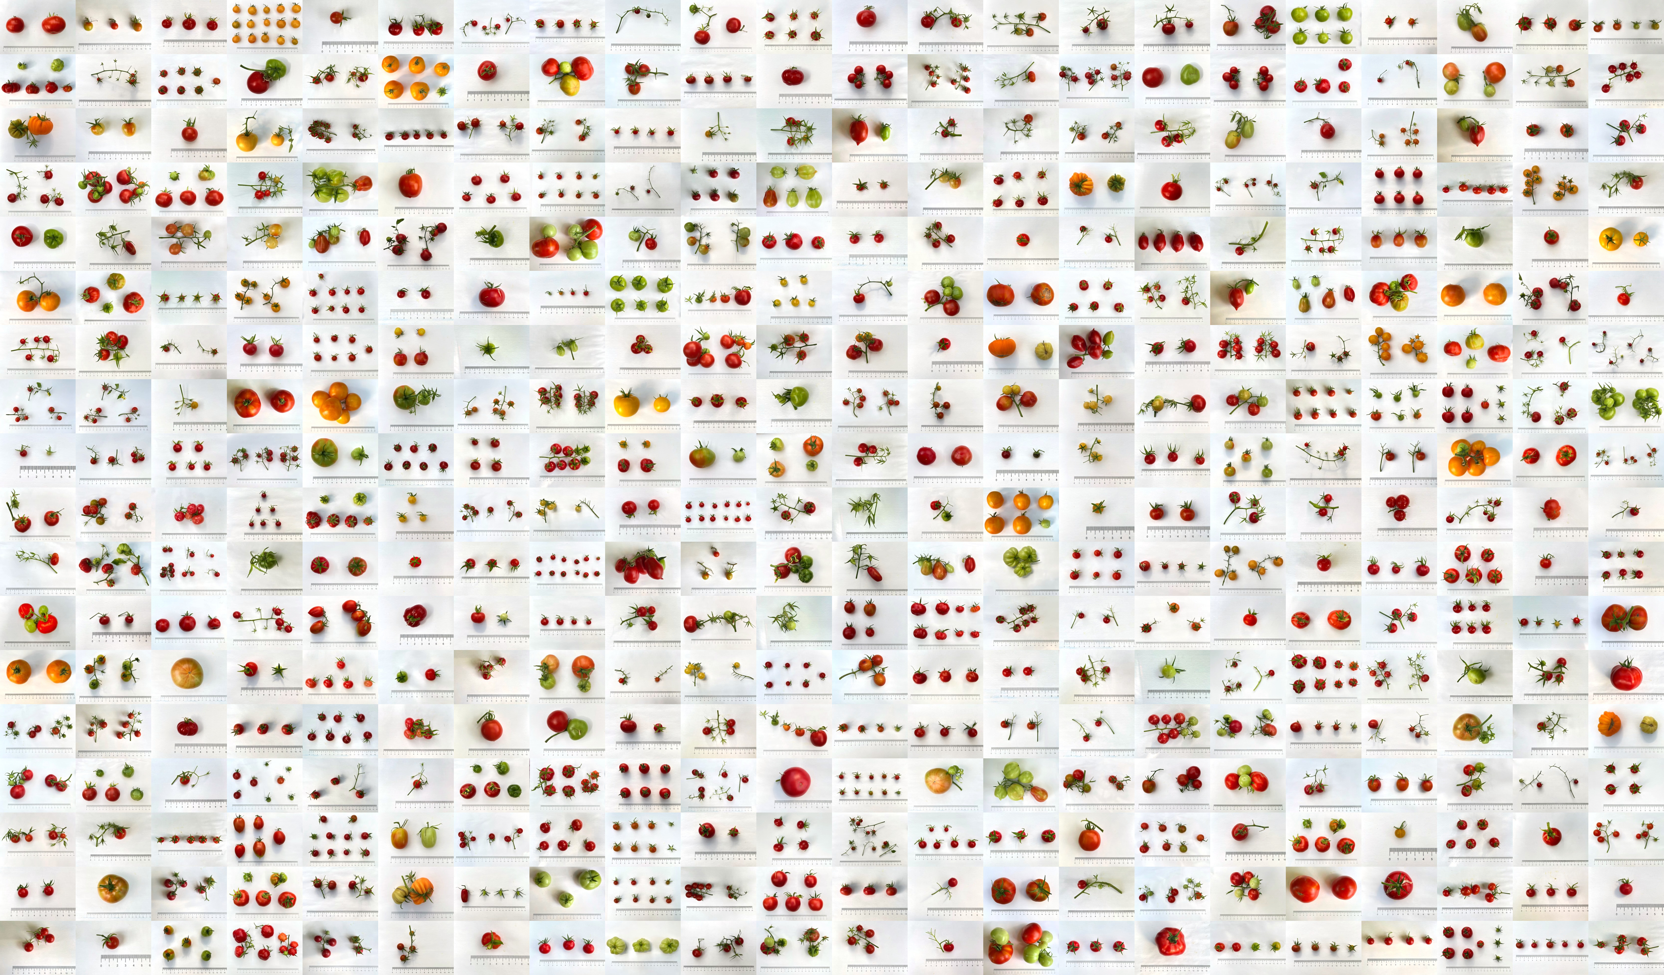
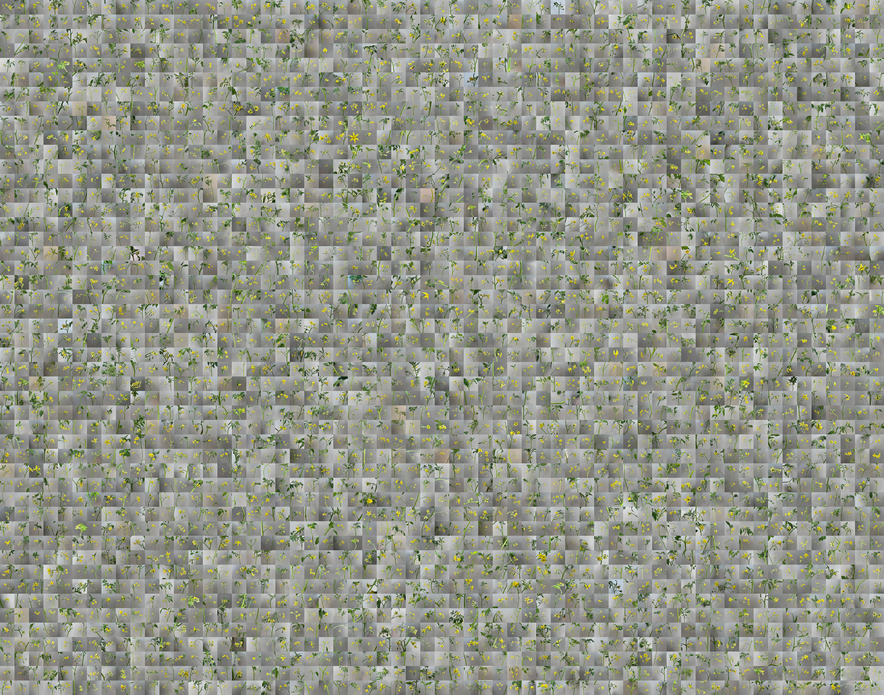
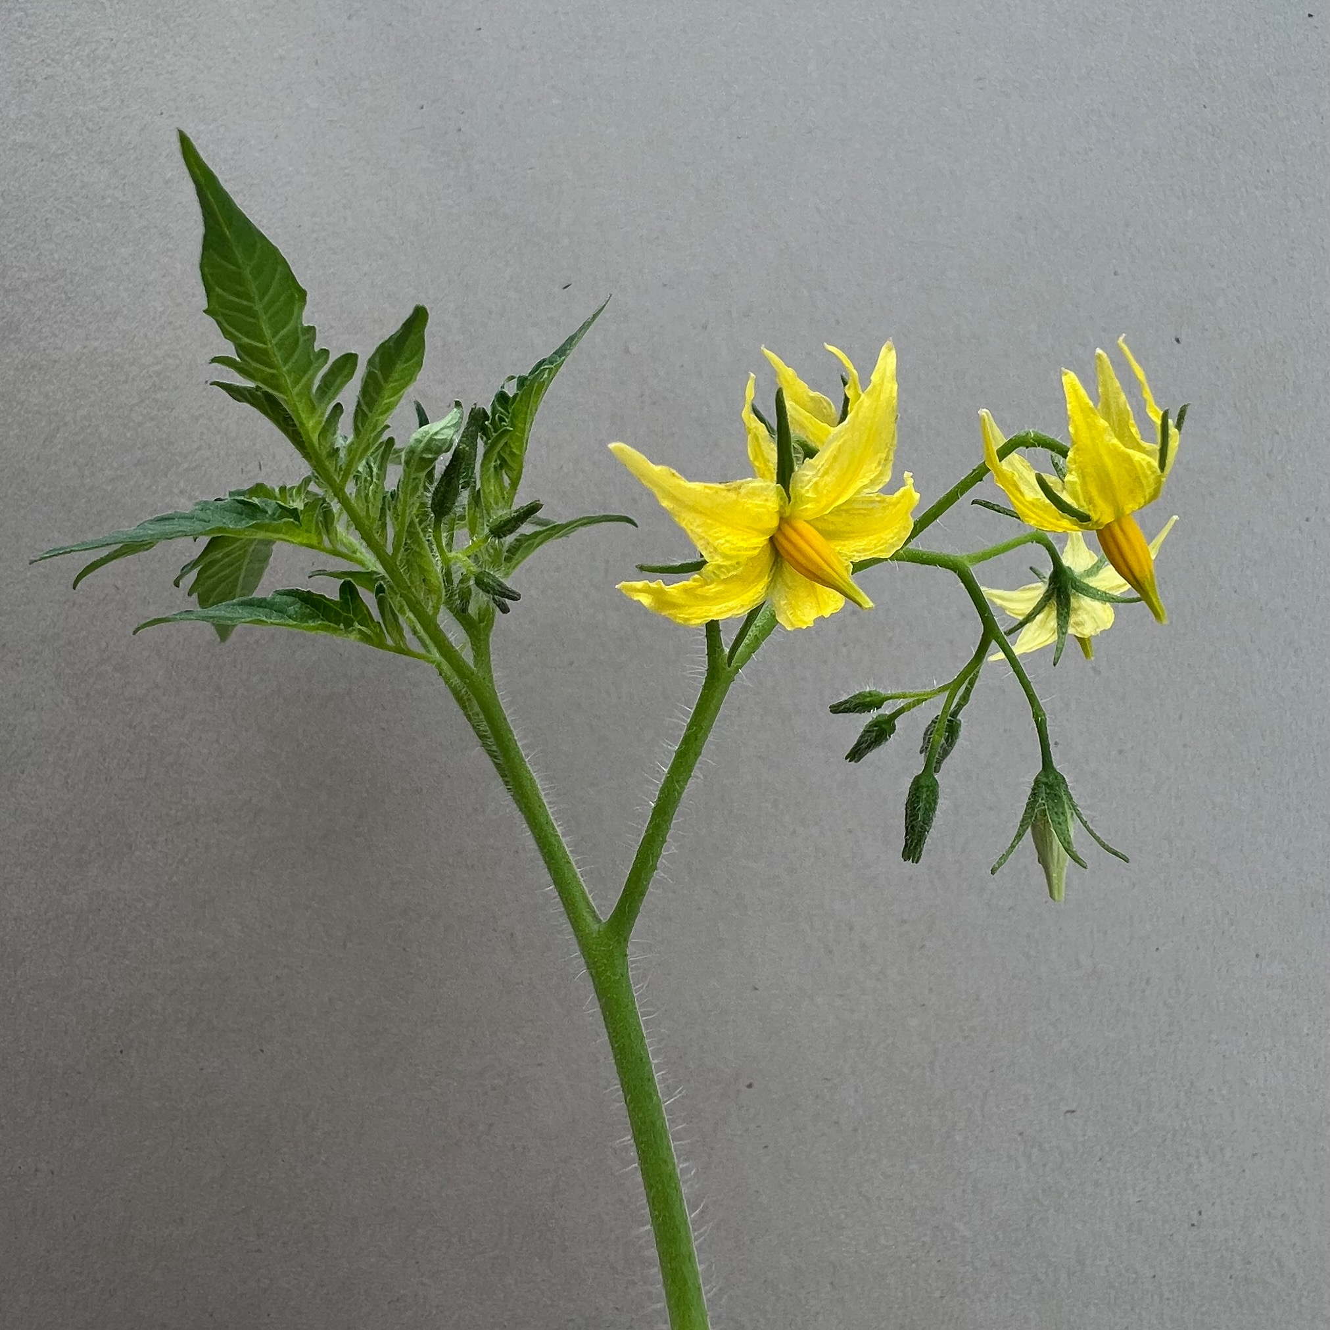
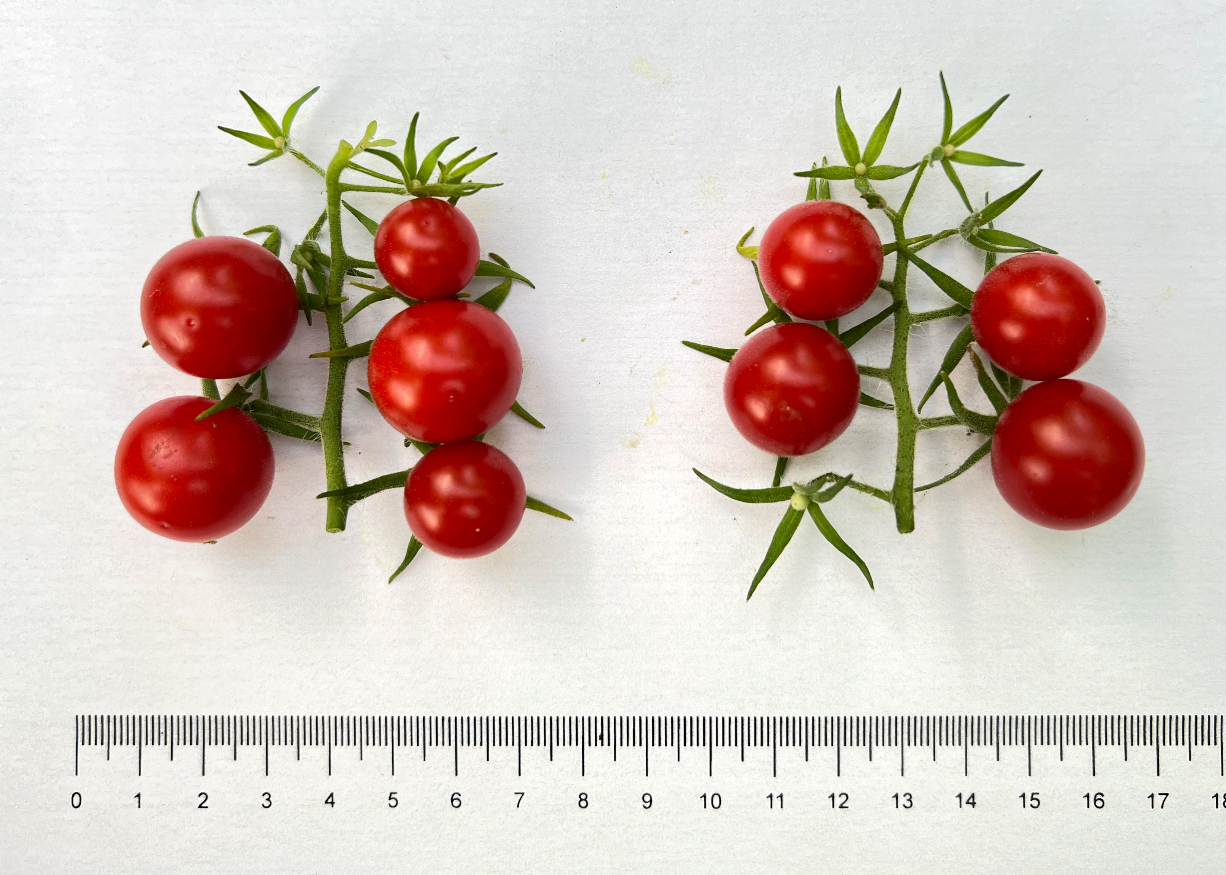
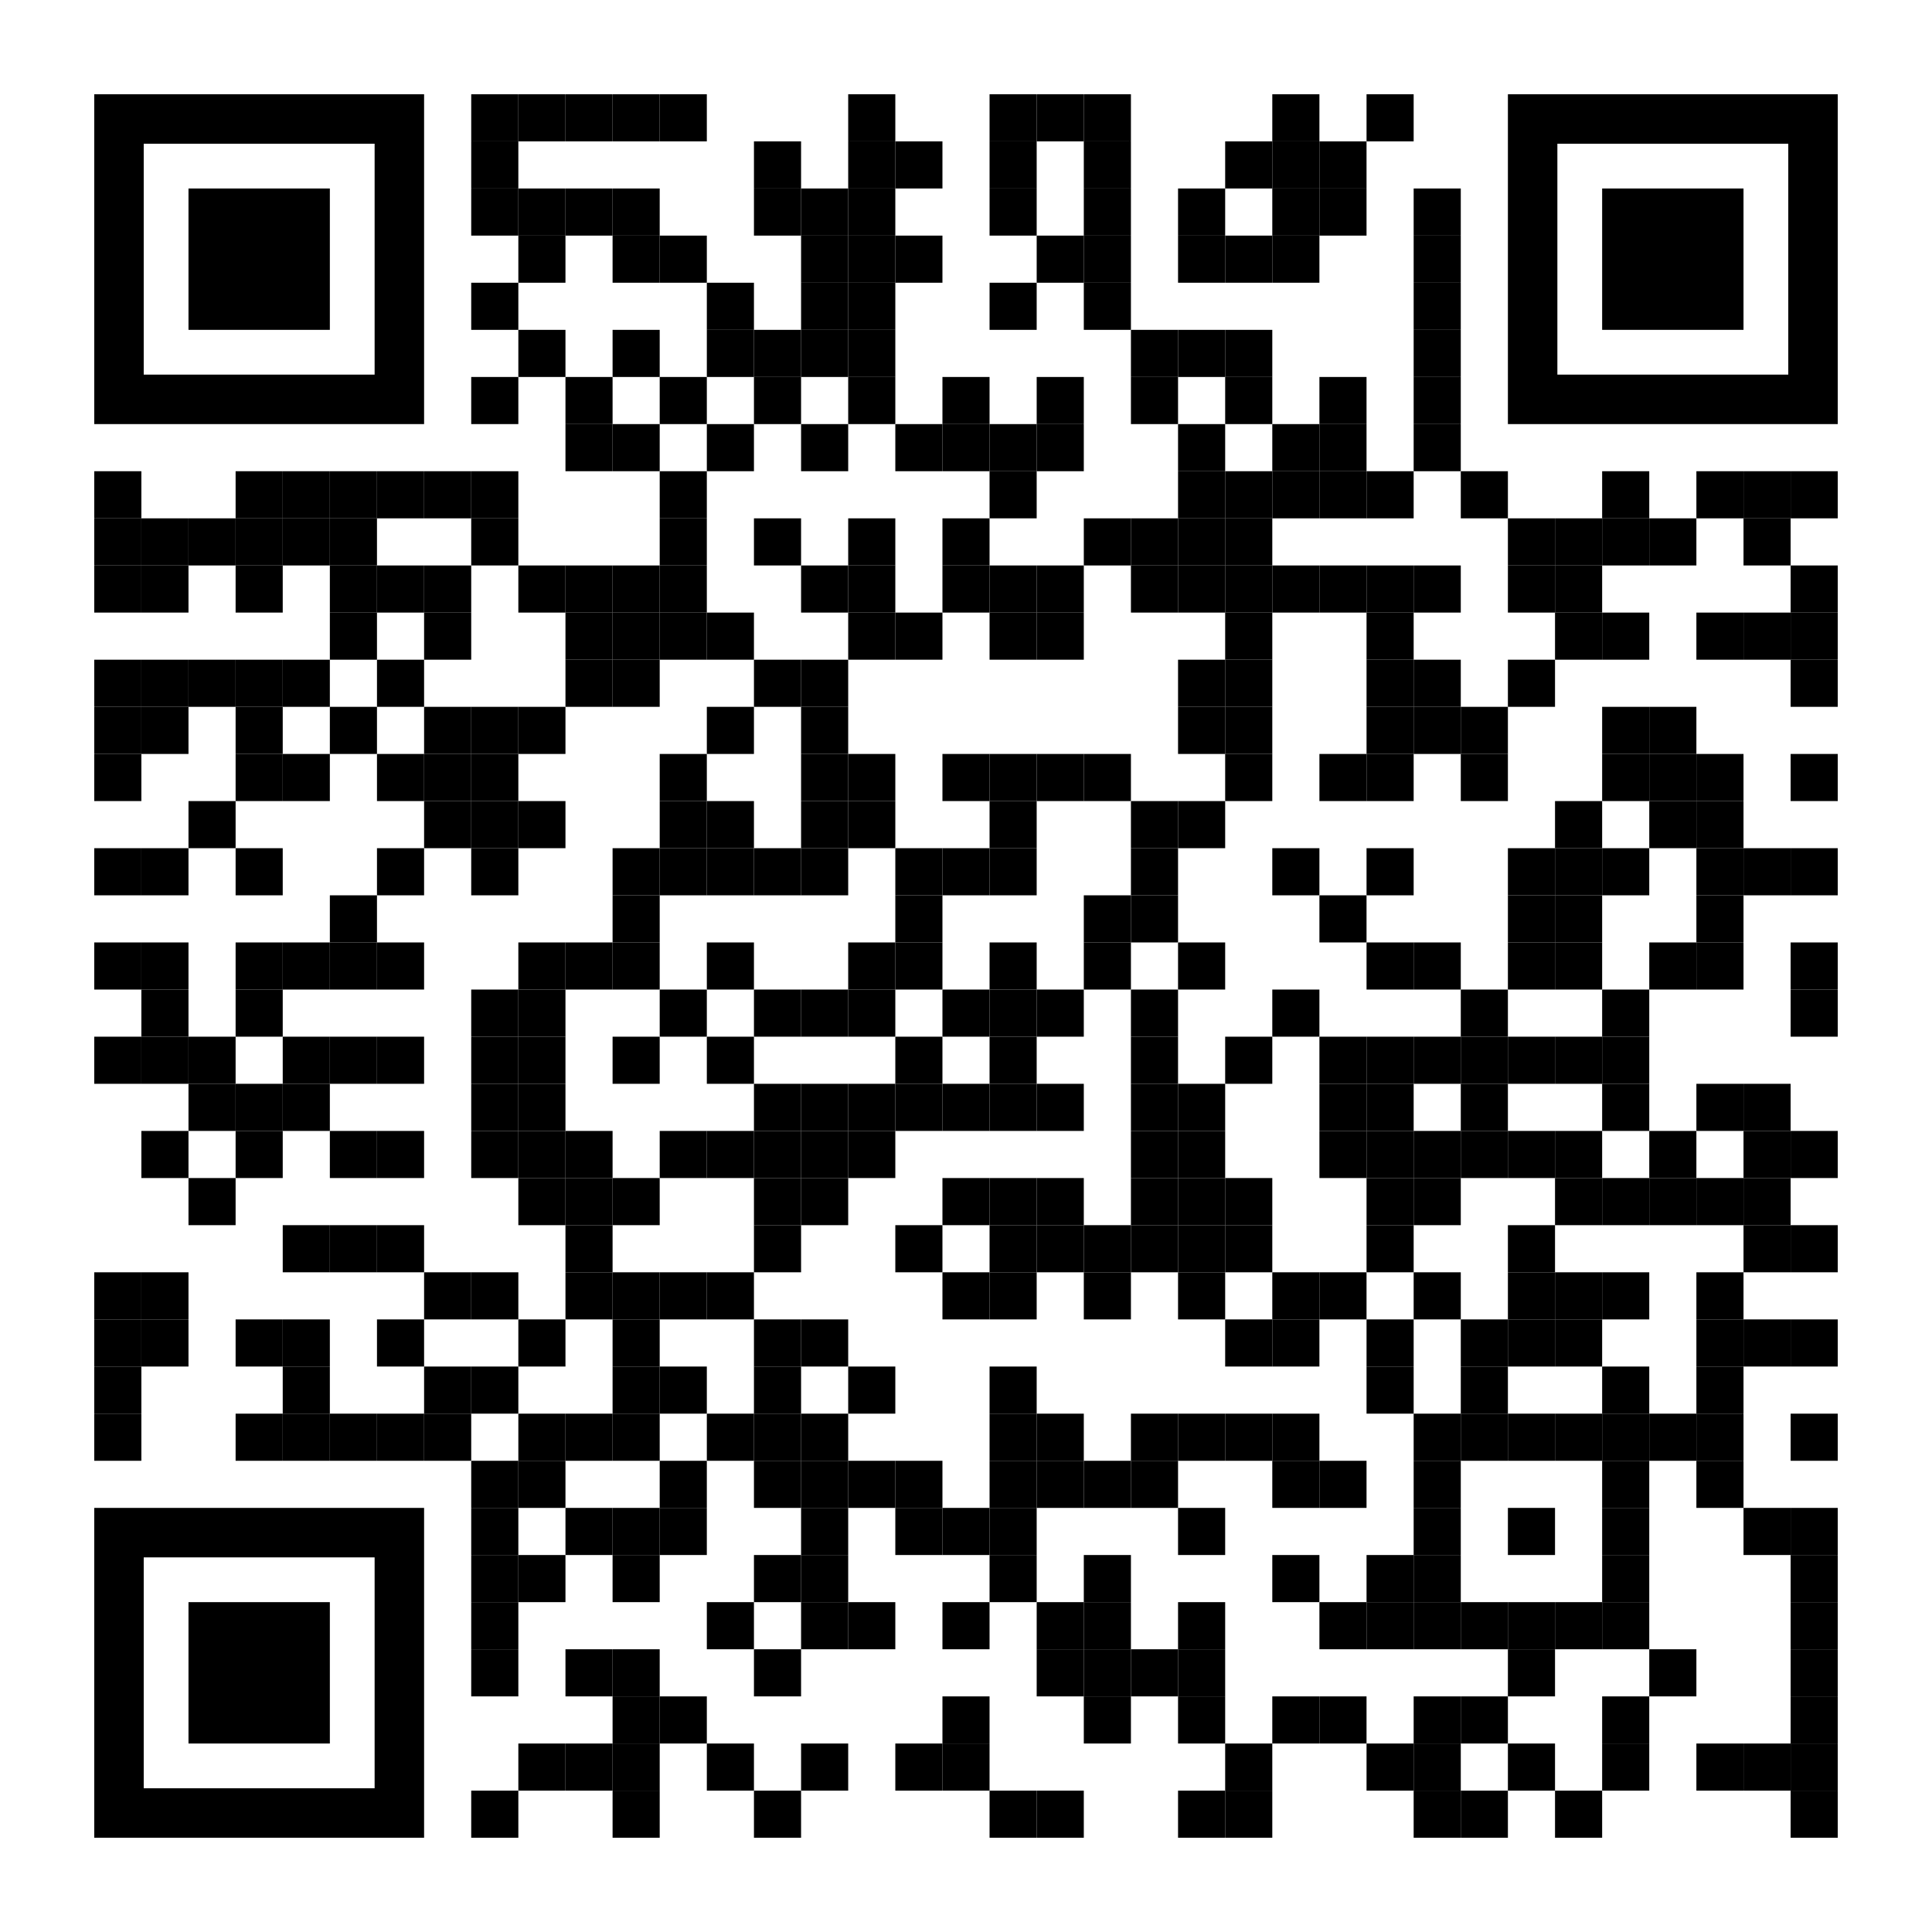

Defining the genetic basis of reproductive heat tolerance
in tomato through high-throughput pollen phenotyping,
genome-wide association, and predictive modeling
Cedar Warman, Sara McKinley, & Ravishankar Palanivelu
School of Plant Sciences, University of Arizona, Tucson, AZ
Abstract
Key steps of plant reproduction, including the development and function of pollen, are disrupted after short periods of excess heat, leading to incomplete fertilization and a reduction in seed and fruit yield. This project will survey pollen tube growth phenotypes under heat stress for a wide variety of tomato cultivars and wild relatives (Aim I). Genetic loci associated with variation in these phenotypes will be identified using genome-wide association studies (Aim II). These data will then be used to predict pollen phenotypes under heat stress for ~1000 sequenced tomato cultivars (Aim III). A broader understanding of heat stress during pollen tube growth will guide future breeding efforts to create novel heat tolerant tomato varieties. In addition, methods developed during this project will be readily adaptable to non-model species, accelerating the process of crop improvement for a wide range of climates. As part of this project, high school, undergraduate, and graduate students will be trained in plant biology, quantitative genetics, and computer vision. Research and outreach will take place in the Palanivelu Laboratory at the University of Arizona.
Tomato flowers and fruits
have a wide range of phenotypes
Heat stress affects pollen tube growth
220 accessions were grown to capture
genetic diversity of tomato and wild relatives
Ratio of anther length to pistil length by accession
100 µm
>275,000 time-series images of pollen tube growth
26 ºC
34 ºC
100 µm
15 min
55 min
90 min
135 min
Acknowledgements
Thank you to Xander Nelson, Yaire Gutierrez, Jorge Munoz, and Katrina Zearley for technical assistance. Thank you to University of Arizona High Performance Computing for computational resources. Thank you to the C.M. Rick Tomato Genetics Resource Center, the USDA National Plant Germplasm System, Esther van der Knaap, and Zachary Lippman for tomato germplasm. This work was funded by National Science Foundation grants IOS-1939255 (Mark Johnson, Ravishankar Palanivelu, Gloria Muday, James Pease, & Ann Loraine) and IOS-2109832 (Cedar Warman).
This poster
is available online:
Acknowledgements
QR code, twitter
@cedarwarman

